Slide 1
Blast-Radius Aware AI Code Review
for Business-Critical Systems.
Your team's attention is limited. Spend review effort where business risk is highest - not spread evenly across every diff.
300 LINE UI TWEAK
Breaks one page.
3 LINE DB CHANGE
Breaks the entire app.
vs
Not all diffs are created equal — so we score and sort every piece of a diff by its blast radius.

Slide 2

LiveReview
AI lets your team produce more code than it can inspect.
So which changes deserve your engineers' scarce attention?
LiveReview ranks every hunk by blast radius and review priority.

Slide 3
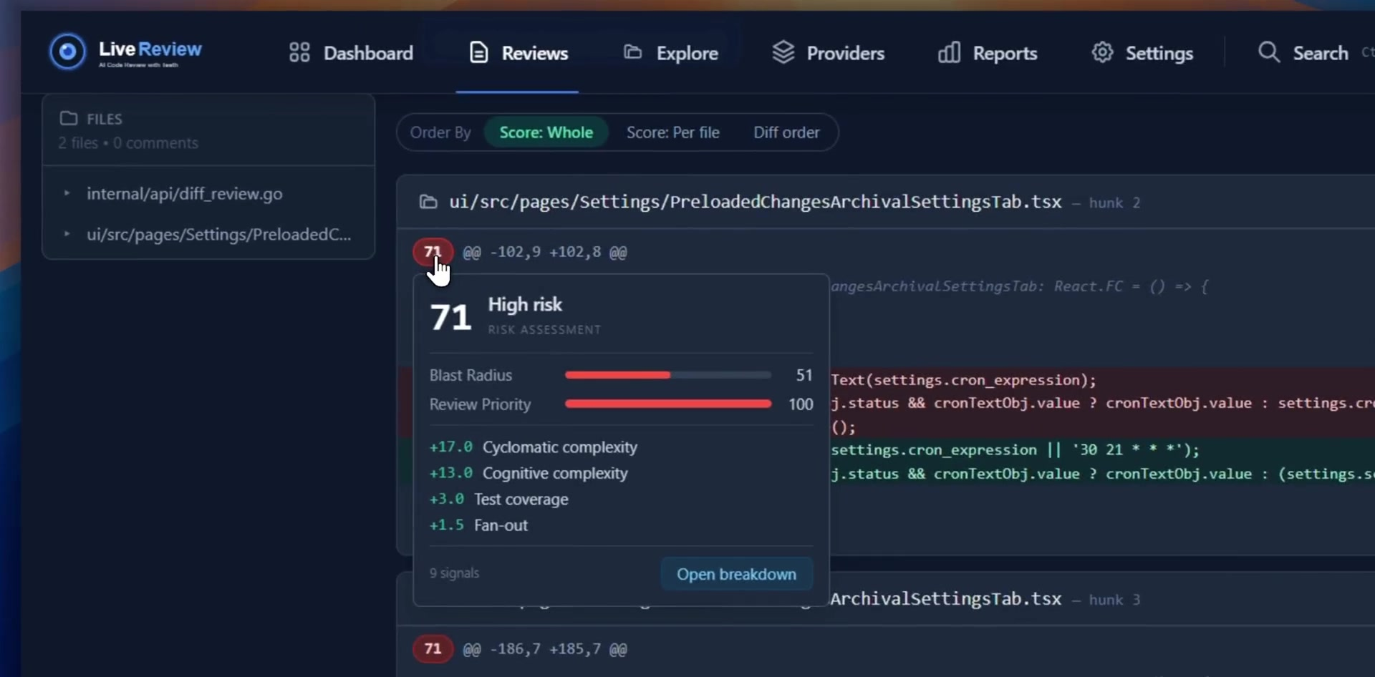
LiveReview
Blast radius tells you what to read first
Each hunk is scored from measurable
signals, so the riskiest change sits at
the top of the review.
Visualize blast radius at a glance
Every factor that feeds the score
Understand the exact math behind the score

Slide 4
LiveReview
A standard is useless when every engineer must
remember to enforce it.
How do you make good review happen every time without slowing the team
down?
LiveReview reviews at commit, push, PR, CI/CD,
and on schedule, enforcing your rules.

Slide 5
LiveReview
Pick the Right Review Depth Based on Your Need for Shipping Speed
Pre Commit Only: local review, fastest, lightest net.
Commit + Scheduled: the startup pick. A daily sweep that catches anything that slipped past commit-time checks.
Commit + Before Push + MR/PR: the standard team flow. A human sees every change before it merges.
All Five (Full Harness): maximum coverage, for repos where a bad change is expensive: payments, auth, core infra.

Slide 6
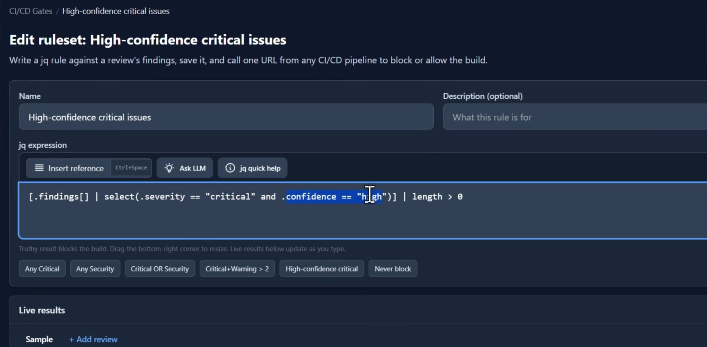
LiveReview
A gate your pipeline can call
Write a jq rule over a review's findings, save it, and call one URL from any CI/CD pipeline to block or allow the build.

Slide 7
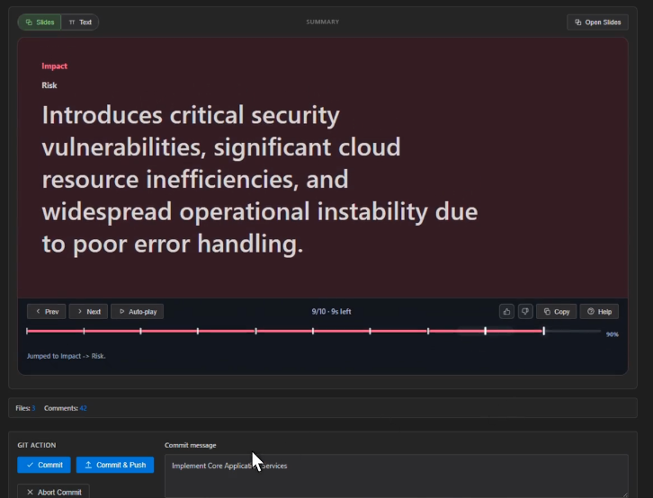
LiveReview
The review reads like a briefing
LiveReview helps you to know what was implemented,
why, and what risks were flagged
in the form of slides, not a wall of diff.
60-second slide summary
Ready to copy-paste PR summary
Quiz on the diff to reinforce understanding

Slide 8
LiveReview
Other reviewers send your code outside your
infrastructure, and seat-based monthly pricing can get
expensive.
Keep your code in your infrastructure and choose which AI models inspect it.
Adaptive Reviews cut AI cost; Livi learns from reviews; CLI, IDE, MCP and
API fit your workflow.

Slide 10
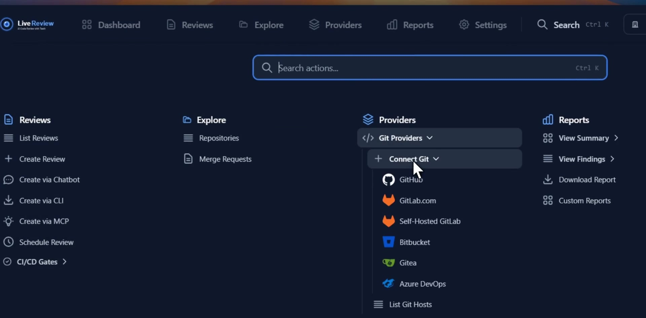
LiveReview
Navigate Easily to Anywhere with simple shortcut (ctrl + k)
Reviews, Explore MR and Repositories,
AI & Git Providers,
Reports and Settings

Slide 11
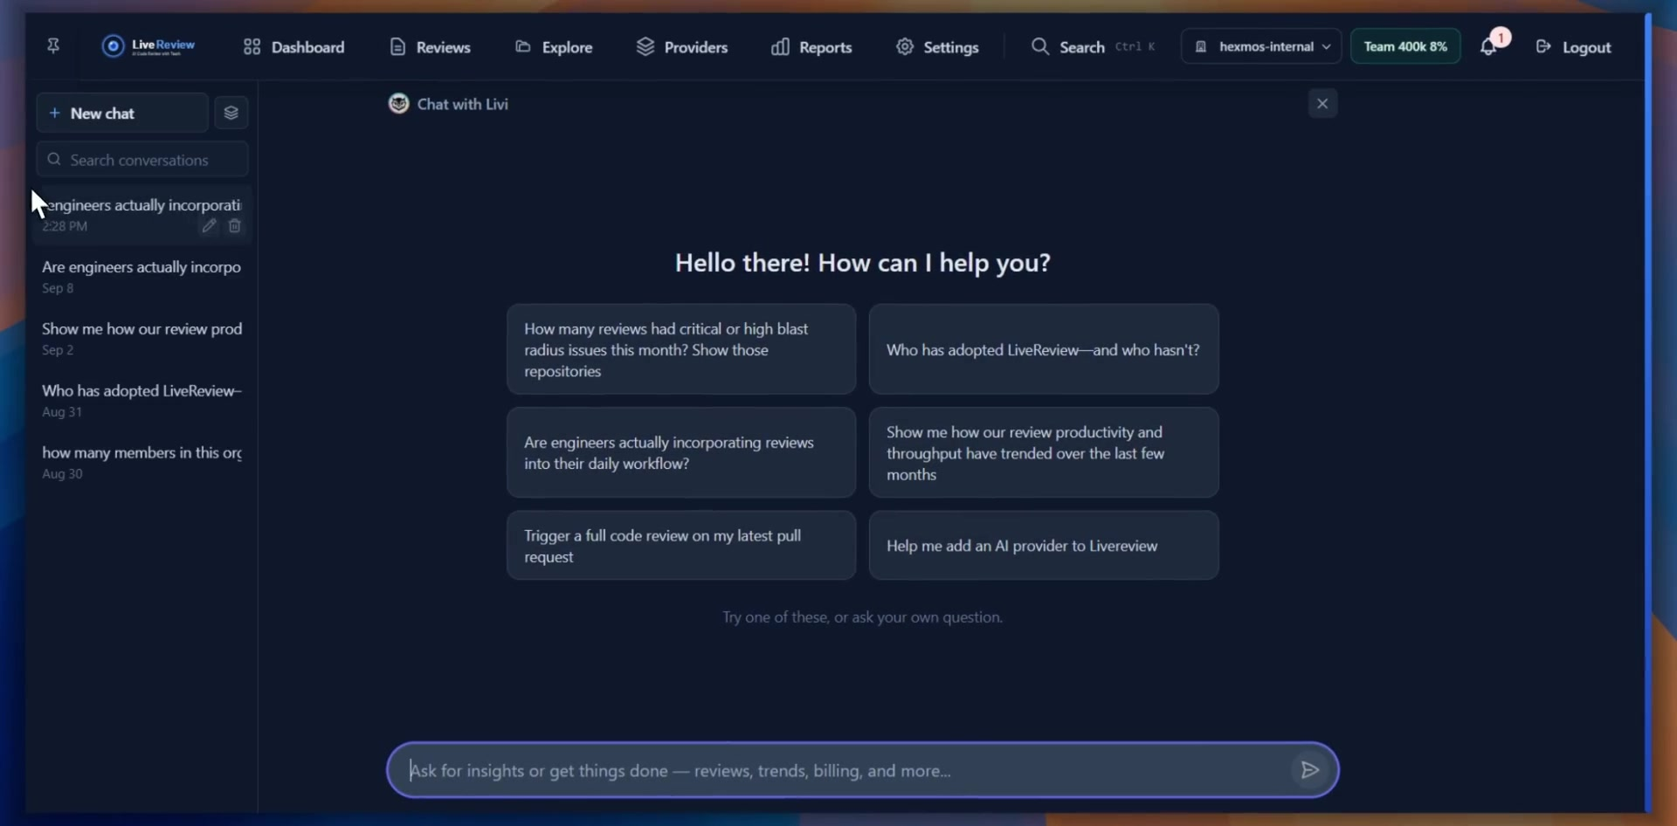
LiveReview
An AI chatbot for your engineering data
Ask Livi a product, engineering,
or ops question in plain English.
It answers with a chart pulled straight
from your organization's own data,
no dashboards to build, no SQL to write.

Slide 12
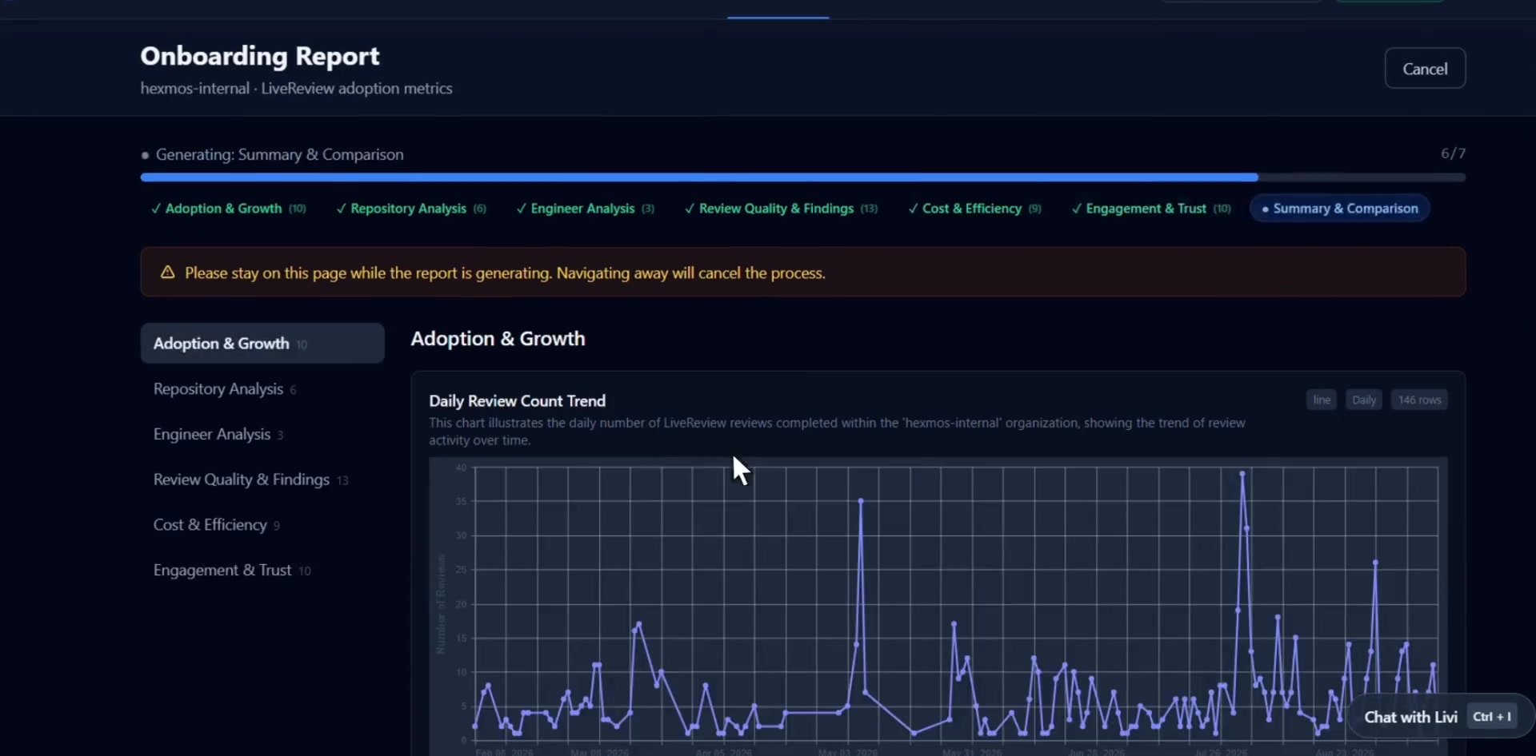
LiveReview
Visualize Adoption, Growth, Review Quality, Cost and Engagement with 50+ Graphs
A generated report on how your
organisation actually adopted
LiveReview.

Slide 13
LiveReview
Three problems. One reviewer.
01
02
02
Capability
Control
Cost
Blast-radius scoring and review-depth controls mean the review engine goes as deep as a change actually warrants, not a fixed shallow pass.
Repository Rules and CI/CD Gates turn agreed standards into checks that actually block a merge, with every skip logged in the audit trail.
Self Hosted, Adaptive Reviews' Leader + Helper model architecture cuts AI inference cost 40-50% without dropping review quality.
hexmos.com/livereview

